Slide 2
The greatest barrier to knowing God’s will is simply that we want to run our own lives. Our problem is that a battle is going on in our hearts—a battle between our wills and God’s will. -Billy Graham

Slide 3
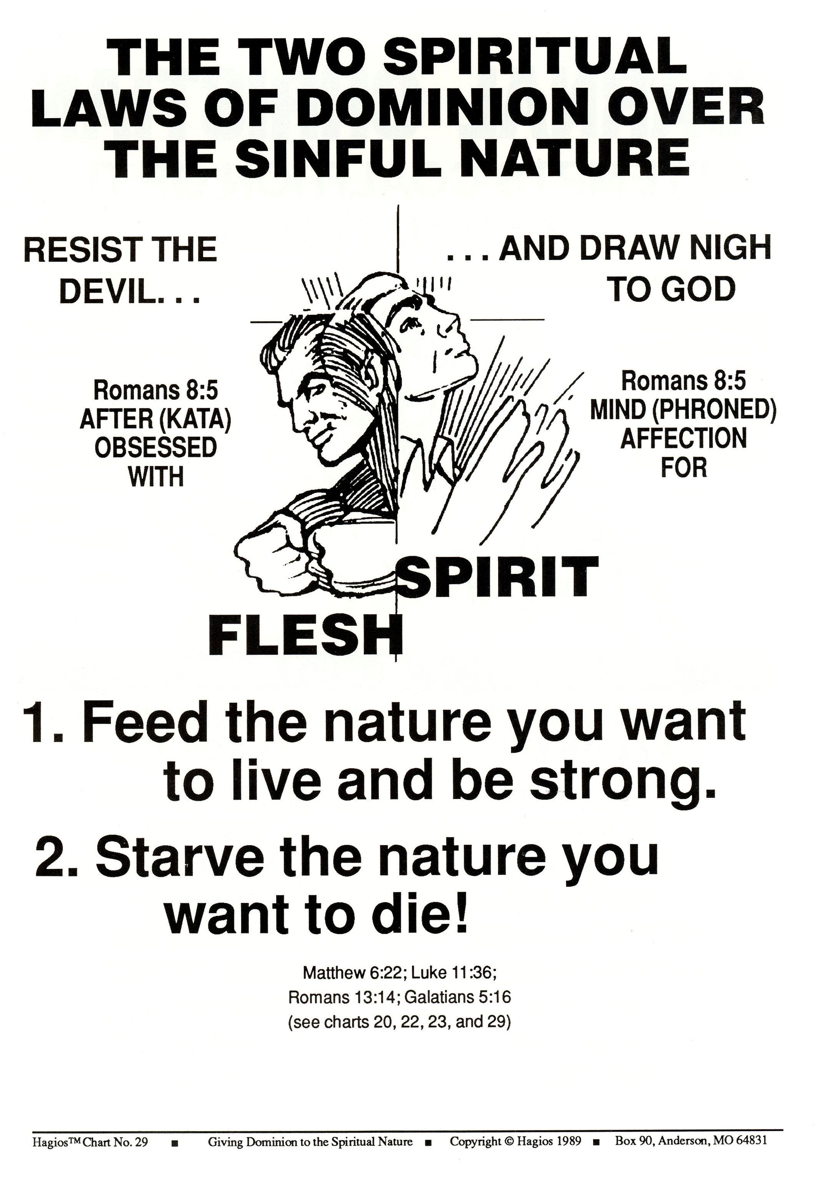

Slide 4
Two Natures: Two natures beat within my breast The one is foul, the one is blessed The one I love, the one I hate. The one I feed will dominate.

Slide 6
